Slide 1
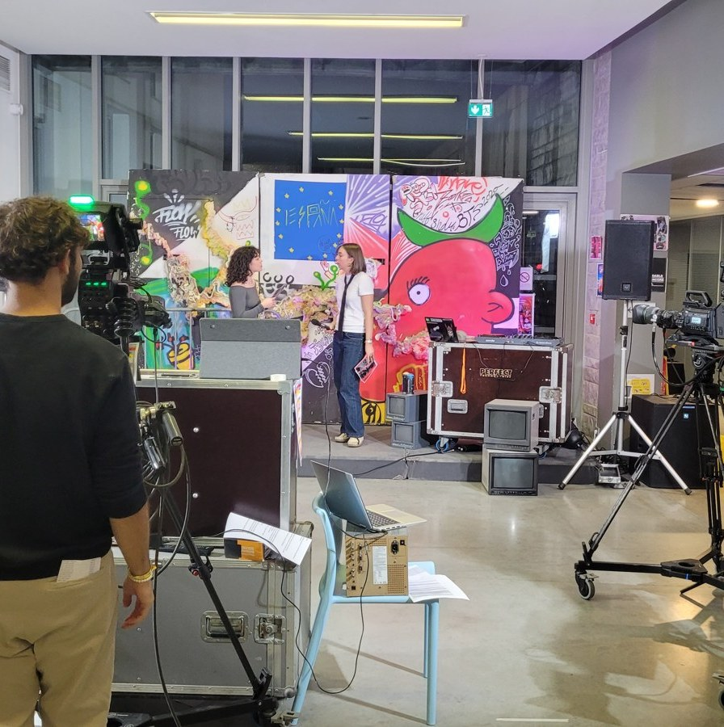



Slide 2
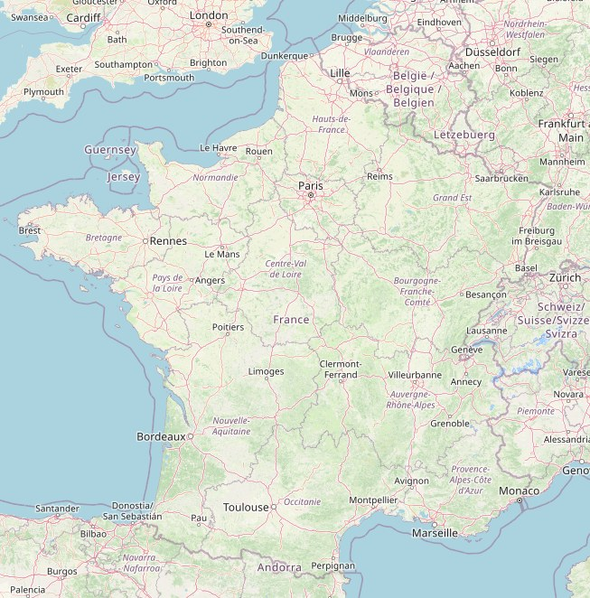
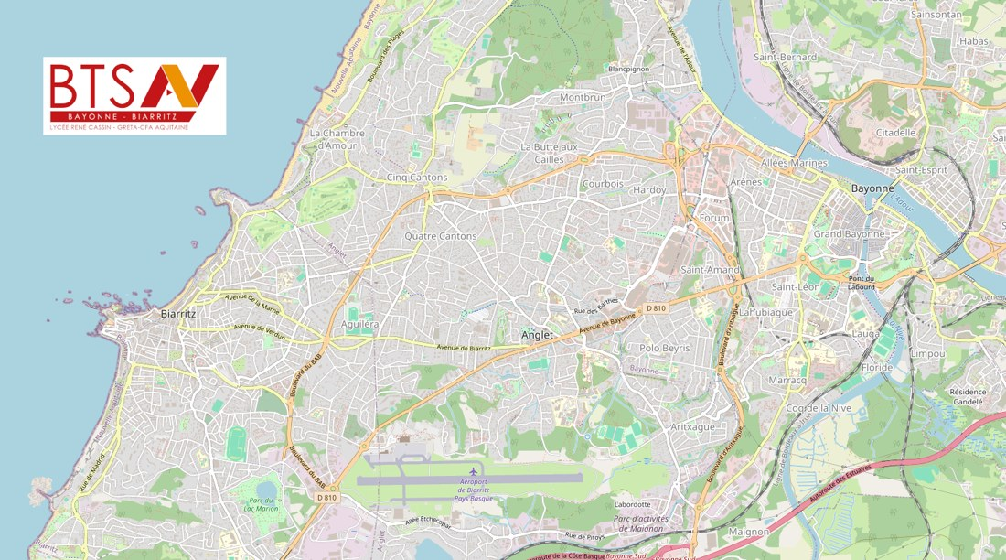
Location
1985
This audiovisual BTS, one of the oldest in France, was created in 1985

Slide 3
Options and class sizes
12 students
24 students
12 students
Sound Professions
Engineering and Equipment Operation Techniques (TIEE)
Editing and Post-Production Professions
96
students in total across the two years

Slide 4
Target Skills: Sound
Sound Professions
1
Analyzing the request
6
Performing low power PA
2
Preparing and installing sound equipment
7
Retrieving and transferring processed sound elements
3
Recording sound
8
Preparing and ensuring proper filing of audio elements and metadata of a production
4
Processing and performing sound postproduction
9
Ensuring safe operations
5
Setting up intercom systems

Slide 5
Target Skills: TIEE
Engineering and Equipment Operation Techniques (TIEE)
1
Analyzing demand and feasibility
5
Managing source switching and element transfers
2
Preparing, configuring and ensuring proper operation of a set of equipment
6
Conforming and checking finalized product
3
Implementing and operating equipment
7
Carrying out live effects
4
Ensuring traffic flow and compatibility of input and output signals
8
Ensuring safe operations

Slide 6
Target Skills: Editing
Editing and Post-Production
1
Seizing on and processing production information
6
Preparing soundtrack for mixing
2
Setting up equipment
7
Preparing and implementing compositing
3
Analyzing and sorting images and sounds
8
Composing multilayer sequences
4
Sharing and pooling project resources
9
Conforming after editing
5
Designing and building editing using storytelling techniques
10
Carrying out finishing

Slide 7
Subjects and hours
Subject | Sound | Editing | TIEE
Audiovisual and artistic culture | 480 | 480 | 360
English | 90 | 90 | 90
Economics and management | 90 | 90 | 90
Applied physical sciences | 240 | 240 | 240
Equipment and media technology | 300 | 300 | 420
Implementation techniques | 660 | 660 | 660
Total | 1860 | 1860 | 1860

Slide 8




Implementation Techniques (TMO)
Project preparation
Equipment setup and operation
Choosing equipment based on artistic, technical and budgetary constraints.
Installation, configuration, cabling, network management, file transfers, etc.
Technical finishing
Coordination and maintenance
Editing and post-production option: preparing editing elements, image finishing (effects, compositing), editing and sound mixing, sound reinforcement.
Equipment engineering and operation option: specification, technical coordination, equipment operation, preventive and corrective maintenance, signal and stream quality.

Slide 9



Equipment & Media Technology (TES)
Equipment use
Audio signal processing, digital processing chain, digital video, recording formats and media.
Knowledge of technologies
Signal transmission and digital techniques, audio and video stream synchronization, concepts of encoding and decoding information.
Maintenance and operation
Selection, installation, configuration, upkeep and checking of camera, sound, editing and broadcast equipment, etc.

Slide 10



Applied Physical Sciences
Electricity and electronics
Optics and light
Acoustics
Circuit basics, components, analog and digital signals.
Study of light, colorimetry, image formation, sensors and lenses.
Sound propagation, audio signal processing, sound reinforcement, microphones, speakers, and capture and broadcast techniques.

Slide 11



Audiovisual and Artistic Culture
Works and authors
ANNUAL THEME
Analysis of films, programs, documentaries, sound works, photographs, etc.
2026
History of arts and media
Evolution of techniques, styles and artistic movements in audiovisual.
“Animal, animalities”
Each year a theme is set nationally, with an indicative bibliography and filmography to study.
The professional world
Audiovisual landscape, broadcast and distribution channels, professions and industry challenges.

Slide 12
Economics and Management
For all options: economics, law, management and communication applied to the audiovisual sector.
01
02
03
Professional environment
The company
Legal framework
Audiovisual, cinema, performing arts, distribution and broadcast channels.
Legal forms, operation, organization and management principles.
Literary and artistic property, personality rights, labor law, social legislation.

Slide 13
Main projects during the program
Live newscasts
Professional Synthesis Exam (EPS)
Throughout the program, students produce live newscasts with reports.
A major exam component: a complete audiovisual project (fiction, documentary, report, multi-camera set, etc.) produced by teams from the different options (sound, editing, operations). Each team handles every stage, from concept to completion, then individually presents its work to a jury of professionals.
6-hour live show
In year two: a 6-hour live show with newscasts, weather, games and reports.
Other projects
FIPADOC, Aimer la Danse, etc. Students may also voluntarily produce audiovisual projects and freely use the program’s equipment.

Slide 14

Classroom time and internships
Since the 2025–2026 school year, Erasmus+ and OFAJ (Franco-German Youth Office) grants allow students to do their internship abroad (Berlin, Canary Islands, Spanish Basque Country, etc.).

Slide 15





Types of companies hosting interns
Regional, national and European television
Post-production
Production, services, events
Radio
Service providers (sales, rental)

